Slide 1


IIT BHU
COSMIC
CLASSIFIER
Presented by
Manvi Jangid
Ricktho Sarkar
Abhinav Barman

Slide 2




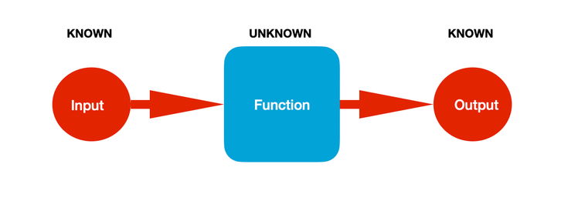

METHODOLOGY
DATA PREPROCESSING
EDA
MODEL SELECTION
MODEL APPLICATION ON TEST SET
MODEL EVALUATION

Slide 3


EDA
AND PREPROCESSING

Slide 4

MISSING VALUE HANDLING
Percentage of null values of all columns were checked.
We converted the categorical columns ‘Magnetic Field Strength ’ and ‘Radiation Levels’ into numerical columns by just extracting the numerical parts of the column values. This was done as it would help us in applying KNN Imputation which requires numeric data only as it involves calculation of Euclidean Distance.
KNN Imputation was applied on all the feature columns. For the target column we avoided imputation and instead went for removal of rows with null values in target column as it was found to have improved the model performance.
The reason for improved performance has been concluded to be the fact that feature column imputation retains valuable data, while target column imputation may tend to introduce unreliable labels.

Slide 5

BOXPLOTS AND WINSORIZATION
Boxplots have been plotted for the various feature and target columns of the dataset to check for outliers.
Subsequently we have applied Winsorization Technique where we have used limits as 0.05 for both higher and lower sides of the distributions of the columns i.e. for each column, bottom 5% values will be replaced by the 5th percentile value and top 5% will be replaced by the 95th percentile value.
Key benefits of Winsorization are:
Reduces the impact of extreme values on statistical analysis.
Preserves all data points, unlike outlier removal techniques.
Useful for handling skewed distributions in financial and scientific data.

Slide 6

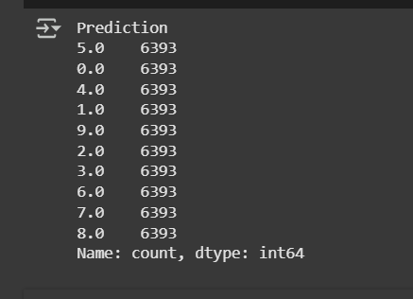
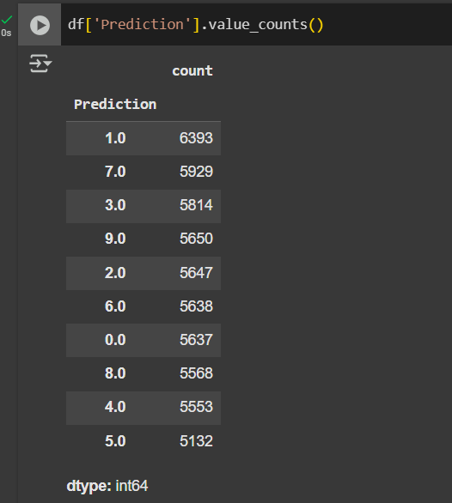
SMOTE TO HANDLE DATASET IMBALANCE
1
2
BEFORE SMOTE
AFTER SMOTE
3
WHY SMOTE?
SMOTE (Synthetic Minority Over-sampling Technique) is a method used to handle class imbalance in classification problems. It generates synthetic samples for the minority class to balance the dataset instead of simply duplicating existing instances.
SMOTE was chosen as the primary imbalance handling technique because it effectively addressed class imbalance without removing valuable data (as in undersampling) or simply duplicating samples (as in random oversampling).
Also unlike class weighting, SMOTE introduced synthetic diversity, improving model performance. Since the application of SMOTE yielded significant improvements, there was no need to explore alternative techniques, making it the most efficient and effective choice for this problem

Slide 7


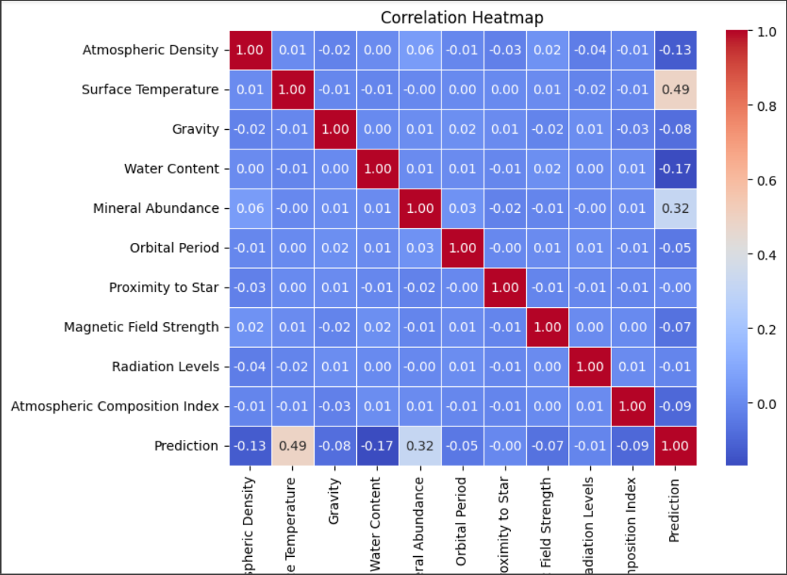
CORRELATION HEATMAP
From the correlation heatmap it was concluded that there wasn't any strong/significant correlation between any of the columns.

Slide 8

MODEL SELECTION,TRAINING AND EVALUATION

Slide 9

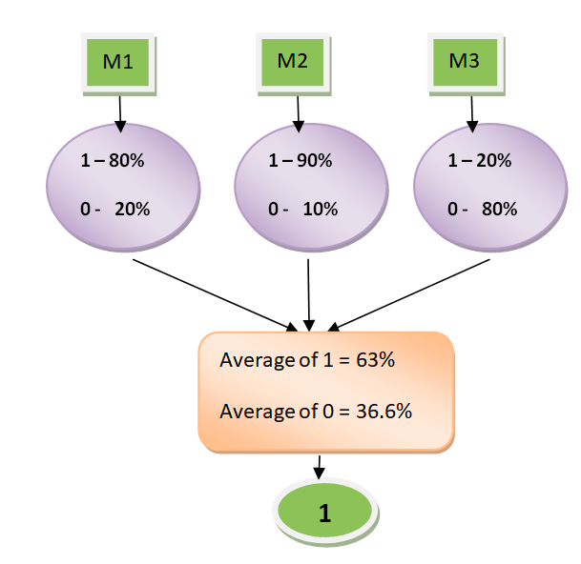
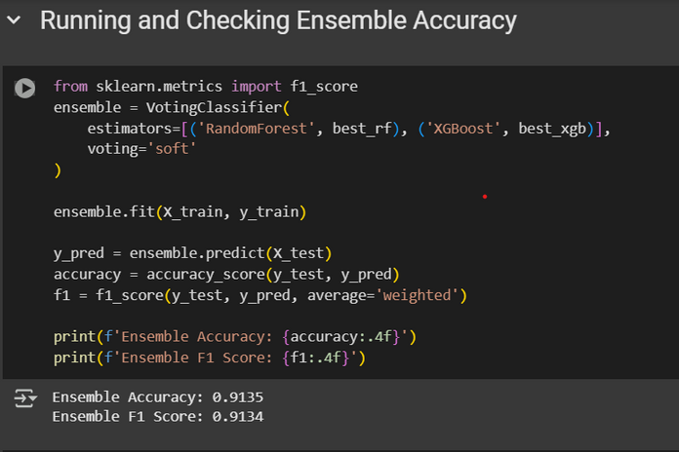
WHICH MODEL?
MODEL EVALUATION
After testing with different models ,we decided to go with a Soft Voting ensemble consisting of Random Forest and XGBoost models, as it provided us with the best results.
Fig. showing Soft Voting
MODEL TRAINING
As specified in the problem statement, we have evaluated our model on Accuracy .
Additionally we have also taken out the F1 Score of our model as an added assurance that our model is working well.
Although we addressed class imbalance, we included F1-score to ensure that our model maintains a balance between precision and recall. Even after balancing the dataset, the model might still favor certain classes or misclassify difficult samples. F1-score provides a more holistic evaluation, ensuring that no class is unfairly overlooked and that both false positives and false negatives are minimized.
For training we have used GridSearch CV on both Random Forest and XGBoost models of the ensemble as a part of hyperparameter tuning process to find the best model.
3 fold cross-validation was employed.
Scoring was assigned accuracy in order to find the best possible hyperparameter combination through GridSearchCV for the Random Forest.
Similar steps were followed for finding the best hyperparameter combination for the XGBoost.
Finally we used the best hyperparameter combination Random Forest and XGBoost models to create our Voting Ensemble and then evaluated it.

Slide 10


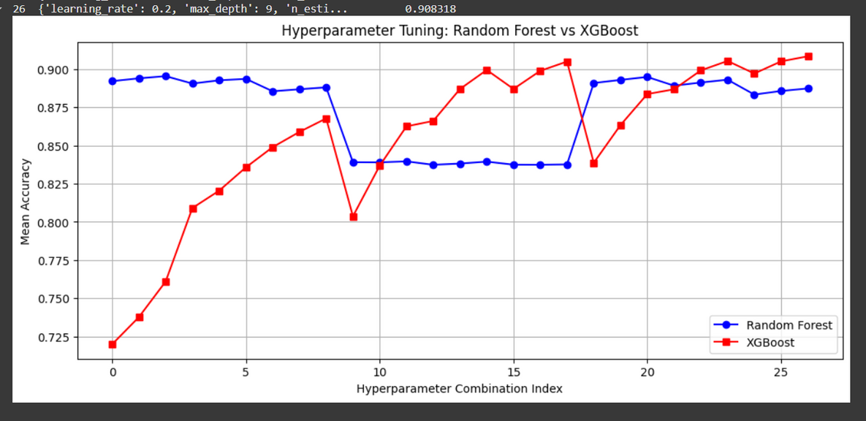
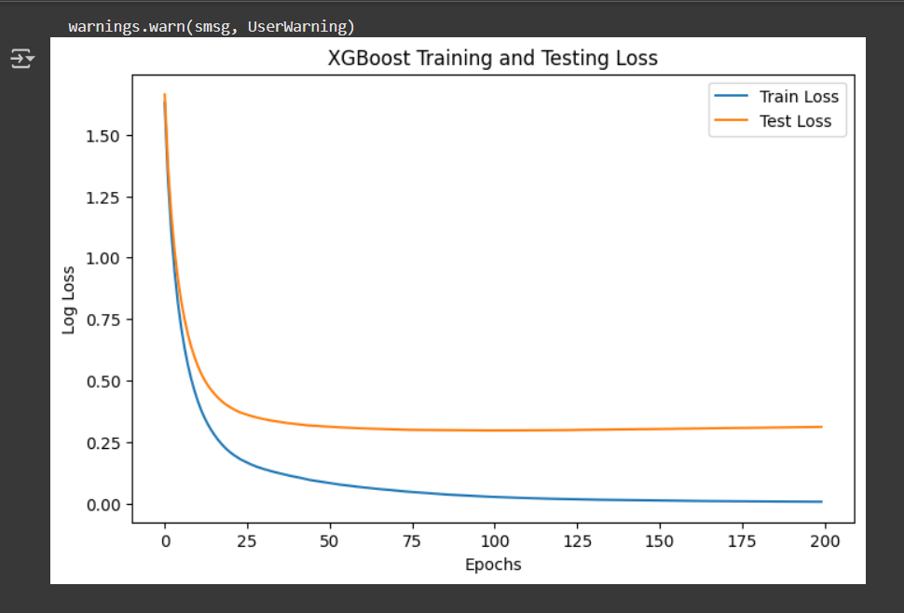
Hyperparameter combination index
XGBoost Training and Testing Loss

Slide 11

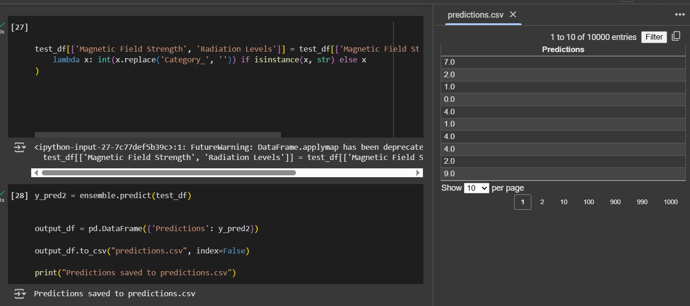
MODEL APPLICATION ON TEST SET

Slide 12

QUESTIONS AND ANSWER

Slide 13

THANK YOU

